Slide 1

Doctoral Study „Agricultural Sciences”
Defence of the doctoral thesis xx.xx.20xx.-enter the date
Doctoral thesis title
Doctoral candidate:
Name and Surname
Mentor/s:
Title. Name and Surname
Zagreb, month 2025

Slide 2
Introduction / Overview / Presentation plan
Reminder: During the public defense, the doctoral candidate presents the research idea within 30 to 45 minutes using a visual presentation. The candidate introduces the problem, the foundational literature, explains the hypotheses and objectives, the materials and methods of the research, presents the research results along with discussion, and concludes by providing answers to the objectives set in the doctoral thesis.
Rule / Help:
What I will say → 1 do 4 slides … INTRODUCTION (introduction to the research)
What to say → 10 do 30 slides … PLOT (hypotheses and objectives; materials and methods of research, research results)
Repeat! → 1 do 4 slides … RESOLUTION (conclusions)
Note:
Use this template – delete the titles, text, and illustrations, and insert your own.
Defence of the doctoral thesis
xx.xx.20xx.

Slide 3
Introduction to the research topic:
List the following:
Questions that arise…
What is known about the problem so far…
What is the motivation for the research…
Hypotheses:
Objectives:
Defence of the doctoral thesis
xx.xx.20xx.

Slide 4
Hypotheses and objectives:
Hypotheses:
Objectives:
Defence of the doctoral thesis
xx.xx.20xx.

Slide 5
Materials and methods of research:
Population, data, variables, analyses...
Describe the research material used, as well as the method of data collection, experimental design, the basic experimental unit, control, dependent and independent variables, sample size, number of repetitions, and experimental error;
the analysis methods (field, laboratory – instruments, in the field, …, statistical) – which methods were used and for what purpose;
and which were used to achieve the set objectives or verify the set hypotheses.
Note:
The research material and methods should be written according to the approved topic of the doctoral thesis.
If there are minor deviations – state the reasons …
Defence of the doctoral thesis
xx.xx.20xx.

Slide 6
Results
List them according to the research structure:
in the presentation of a doctoral thesis, the results should be
visually presented in the form of tables, graphs, images, ... and
orally explained (discussed) their meaning and critical comparison with the results of similar studies.
Defence of the doctoral thesis
xx.xx.20xx.

Slide 7
Conclusions
Answers to the research tasks set:
in presenting the conclusions, it is important to clearly follow the set hypotheses or objectives.
the answers to the research tasks should be written in bullet points and presented descriptively.
Defence of the doctoral thesis
xx.xx.20xx.

Slide 8
Public defense of the doctoral thesis
Preparation of the presentation:
present the content of the doctoral thesis in 30-45 minutes
do not exceed the time, but do not shorten it excessively
focus and emphasize the essentials
follow the content present the work coherently
organized plan and practice in advance
Defence of the doctoral thesis
xx.xx.20xx.

Slide 9
Public defense of the doctoral thesis
Preparation of slides:
A maximum of 30 to 40 slides
each slide must have a title
carefully design titles
do not number titles, subtitles, tables and graphs
use short phrases, nouns, verbs – short bullet points, not full sentences
adhere to the “golden 6” rule – 6 points per slide and 6 words per point
Defence of the doctoral thesis
xx.xx.20xx.

Slide 10
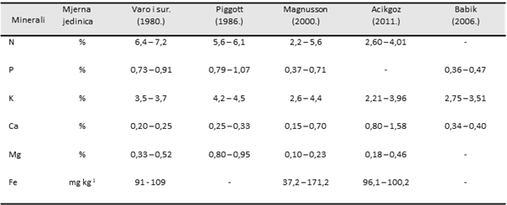
Public defense of doctoral thesis
Preparation of slides – tables and graphs:
present the results in the form of tables and graphs - size !
the titles of all illustrations - tables, pictures..., should be positioned above
do not include labels or numbering in the titles.
- do not write: Table 4.2.1., Table 4.3.2., Figure 2.1.,
use symbols to refer to footnotes/legends.
pay attention to the size of the letters/numbers... readability of the table!
Minerals |  | Varo et al. (1980.) | Piggott (1986.)
N | % | 6,4 – 7,2 | 5,6 – 6,1
P | % | 0,73 – 0,91 | 0,79 – 1,07
K | % | 3,5 – 3,7 | 4,2 – 4,5
Ca | % | 0,20 – 0,25 | 0,25 – 0,33
Mg | % | 0,33 – 0,52 | 0,80 – 0,95
Fe | mg kg⁻¹ | 91 - 109 | -
X
✓
Source: … specify the source!!!
Defence of the doctoral thesis
xx.xx.20xx.

Slide 11
Public defense of the doctoral thesis
Useful tips for creating a good visual presentation:
do not write text ONLY IN CAPITAL LETTERS - it is difficult to read, choose a clear font - Arial, Calibri, ...
font size from 16 to 40 points - depending on the importance of the information:
Title, Subtitle, text_a, text_b.
consistency in style, appearance, text color
titles, points and subpoints ... use bullet points.
text - in clear contrast with the background
limit the use of punctuation marks
check what is written - spelling, proofreading ...
Defence of the doctoral thesis
xx.xx.20xx.

Slide 12
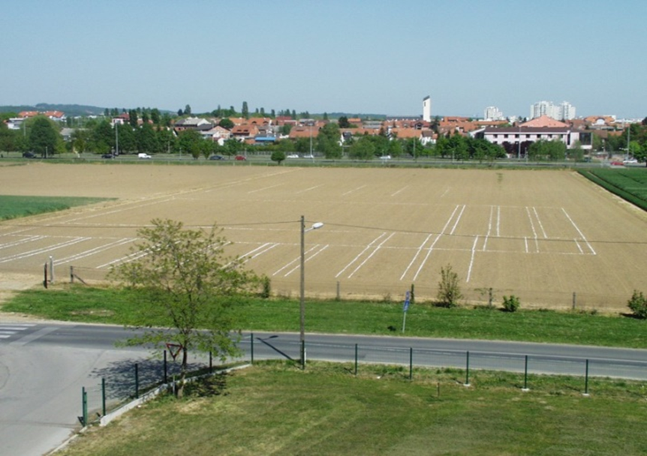
Public defense of the doctoral thesis
Useful tips for creating a good visual presentation:
images – sufficient resolution
resize in ppt diagonally
Source: … specify the source!!!
Defence of the doctoral thesis
xx.xx.20xx.

Slide 13
Public defense of doctoral thesis
Useful tips for oral presentation:
try your entire defense (ppt + oral) with a time check, at least once!
check if everything is working properly – computer, projector, …
present the defense while standing
speak clearly and loudly enough
look at the audience - the committee
pay attention to body language, gestures, intonation
do not read from the slides
Defence of the doctoral thesis
xx.xx.20xx.

Slide 14
Public defense of the doctoral thesis
Date of defense:
Entering the defense date:
Insert
Date and time
Enter the date – xx.xx.20xx.
Apply to all
Defence of the doctoral thesis
xx.xx.20xx.

