Slide 1

Doctoral thesis title proposal
Doctoral Study „Agricultural Sciences”
Public defense of the doctoral thesis proposal
xx.xx.20xx.-enter the date
Doctoral candidate:
Name and Surname
Proposed mentor/s:
Title. Name and Surname
Zagreb, month 2025

Slide 2
Introduction / Overview / Presentation plan
Reminder: At the public defense of doctoral thesis proposal, the doctoral candidate presents the basic idea of ​​the research in 15 to 20 minutes using a visual presentation - introduces the problem, foundational literature, clarifies the hypotheses and objectives, the materials and methods of research and highlights the expected scientific contribution of the doctoral thesis
Rule / Help:
What I will say → 1 do 2 slides … INTRODUCTION
What to say → 10 do 15 slides … PLOT
Repeat! → 1 do 2 slides … RESOLUTION
Note:
Use this template – delete the titles, text, and illustrations, and insert your own.
Defence of the doctoral thesis proposal
xx.xx.20xx.

Slide 3
Problem – describe:
Hypotheses … Objectives …
List the following:
Questions that arise …
Explain the importance of the research topic …
What is known about the problem so far …
What is the motivation for the research …
Hypotheses:
Objectives:
Defence of the doctoral thesis proposal
xx.xx.20xx.

Slide 4
Materials and methods of research:
Population, data, variables, analyses...
Describe the planned
research material, as well as the method of data collection, experimental design, the basic experimental unit, control, dependent and independent variables, sample size, number of repetitions, and experimental error
the analysis methods (field, laboratory – instruments, in the field, …, statistical methods) – which methods and for what purpose
and which will be used to achieve the set objectives or verify the set hypotheses.
Defence of the doctoral thesis proposal
xx.xx.20xx.

Slide 5
Expected scientific contribution of the proposed research:
The dissertation as a scientific work
Highlight what will make this dissertation a scientific work – what is new, innovative, interdisciplinary, multidisciplinary, relevant, ... - original?
Defence of the doctoral thesis proposal
xx.xx.20xx.

Slide 6
Public defense of the doctoral thesis proposal
Preparation of the presentation:
present the content of the doctoral thesis topic in 15 to 20 minutes
do not exceed the time, but do not shorten it excessively
focus and emphasize the essentials
follow the content and present the work coherently and organized
plan and practice in advance
Defence of the doctoral thesis proposal
xx.xx.20xx.

Slide 7
Public defense of the doctoral thesis proposal
Preparation of slides:
A maximum of 15 to 20 slides
each slide must have a title
carefully design titles
do not number titles, subtitles, tables and graphs
use short phrases, nouns, verbs – short bullet points, not full sentences
adhere to the “golden 6” rule – 6 points per slide and 6 words per point
Defence of the doctoral thesis proposal
xx.xx.20xx.

Slide 8
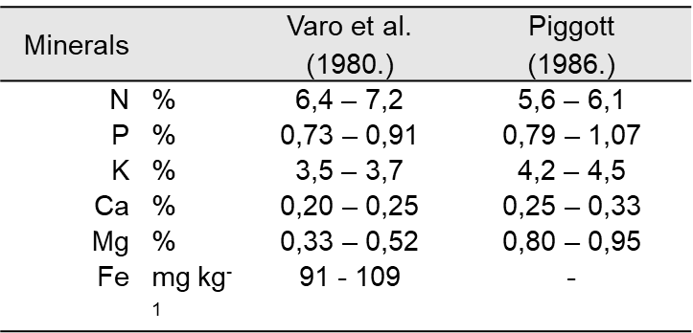
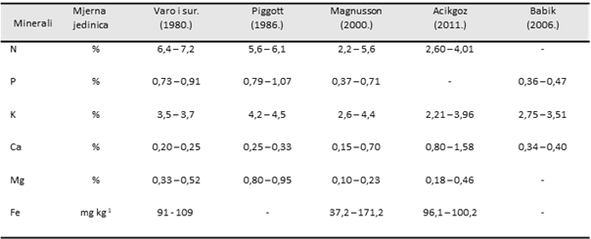
Public defense of the doctoral thesis proposal
Preparation of slides – tables and graphs:
the titles of all illustrations - tables, pictures..., should be positioned above
do not include labels or numbering in the titles.
- do not write: Table 4.2.1., Table 4.3.2., Figure 2.1.,
use symbols to refer to footnotes/legends.
pay attention to the size of the letters/numbers... readability of the table!
✓
Source: … specify the source!!!
X
Defence of the doctoral thesis proposal
xx.xx.20xx.

Slide 9
Public defense of the doctoral thesis proposal
Useful tips for creating a good visual presentation:
do not write text ONLY IN CAPITAL LETTERS - it is difficult to read, choose a clear font - Arial, Calibri, ...
font size from 16 to 40 points - depending on the importance of the information:
Title, Subtitle, text_a, text_b.
consistency in style, appearance, text color
titles, points and subpoints ... use bullet points.
text - in clear contrast with the background
limit the use of punctuation marks
check what is written - spelling, proofreading ...
Defence of the doctoral thesis proposal
xx.xx.20xx.

Slide 10
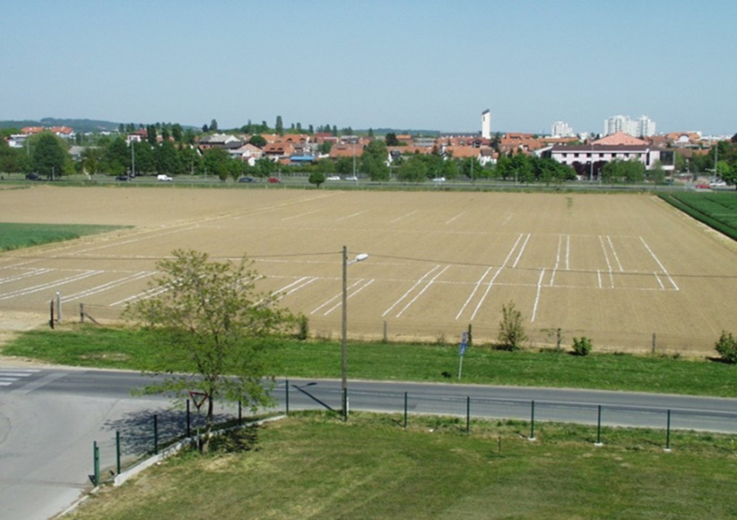
Public defense of the doctoral thesis proposal
Useful tips for creating a good visual presentation:
images – sufficient resolution
resize in ppt diagonally
Source: … specify the source!!!
Defence of the doctoral thesis proposal
xx.xx.20xx.

Slide 11
Public defense of the doctoral thesis proposal
Useful tips for oral presentation:
try your entire defense (ppt + oral) with a time check, at least once!
check if everything is working properly – computer, projector, …
present the defense while standing
speak clearly and loudly enough
look at the audience - the committee
pay attention to body language, gestures, intonation
do not read from the slides
Defence of the doctoral thesis proposal
xx.xx.20xx.

Slide 12
Public defense of the doctoral thesis proposal
Date of defense:
Entering the defense date:
Insert
Date and time
Enter the date – xx.xx.20xx.
Apply to all
Defence of the doctoral thesis proposal
xx.xx.20xx.

