Slide 1
Title Name Surname
Name Surname
Title Name Surname

Slide 3
Introduction / Overview / Presentation plan
Rule:
what am I going to say → 1 to 2 slides
to say that → 10 to 15 slides
repeat! → 1 to 2 slides

Slide 4
An issue
Questions that arise...
The problem is known so far...
Hypotheses
Goals

Slide 5
Public thesis defence
present the content of the thesis for 15-20 minutes
do not exceed the time, but do not excessively shorten it
focus on the essential, follow the content and present the work in a coherent and organized manner
ahead and practice
10 – 15 slides at most
stick to the "golden 6" rule - 6 points per slide and 6 words per point

Slide 6
Useful tips for creating a good visual presentation of the thesis
results in the form of tables and graphs - size !
the titles of all illustrations - tables, pictures..., should be positioned above
leave out marks and numbers
  do not write : Table 4.2.1., Table 4.3.2., Figure 2.1., ...
use short expressions, nouns, verbs - in short, notes, not whole sentences
Minerals | Measuring unit | Varo et al. (1980) | Piggott (1986) | Magnusson (2000) | Acyggosis (2011) | Grandmother (2006)
N | % | 6.4 – 7.2 | 5.6 – 6.1 | 2.2 – 5.6 | 2.60 – 4.01 | -
P | % | 0.73 – 0.91 | 0.79 – 1.07 | 0.37 – 0.71 | - | 0.36 – 0.47
K | % | 3.5 – 3.7 | 4.2 – 4.5 | 2.6 – 4.4 | 2.21 – 3.96 | 2.75 – 3.51
What | % | 0.20 – 0.25 | 0.25 – 0.33 | 0.15 – 0.70 | 0.80 – 1.58 | 0.34 – 0.40
Mg | % | 0.33 – 0.52 | 0.80 – 0.95 | 0.10 – 0.23 | 0.18 – 0.46 | -
Fe | mg kg ⁻¹ | 91 - 109 | - | 37.2 – 171.2 | 96.1 – 100.2 | -
Minerals |  | Varo et al. (1980) | Piggott (1986)
N | % | 6.4 – 7.2 | 5.6 – 6.1
P | % | 0.73 – 0.91 | 0.79 – 1.07
K | % | 3.5 – 3.7 | 4.2 – 4.5
Ca | % | 0.20 – 0.25 | 0.25 – 0.33
Mg | % | 0.33 – 0.52 | 0.80 – 0.95
Fe | mg kg ⁻¹ | 91 - 109 | -
✓
Source: ... state the source !!!

Slide 7
Useful tips for creating a good visual presentation of the thesis
do not write the text ONLY IN CAPITAL LETTERS - it is difficult to read
choose a clear and legible font - Arial, Calibri, ...
font size from 16 to 40 points – depending on the importance of the information
consistency in style, appearance, text colour
  headings, bullets and sub-bullets
text – in clear contrast with the background
limit the use of punctuation marks
check the writing - text, proofreading...

Slide 8
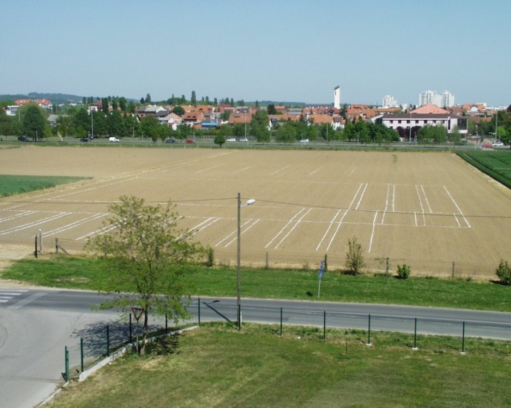
Useful tips for creating a good visual presentation of the thesis
Source: ... state the source !!!
images – of sufficient resolution
change the size in ppt diagonally

Slide 9
Useful tips for oral presentations
expose the defence in a standing position
do not read from the slides
speak clearly and loud enough
look at the audience - the committee
pay attention to body language, gesticulation, intonation
test your entire defence (ppt + oral) with checking the time, at least once!
check if everything is working properly - computer, projector...

